Slide 1
Extraction of embedded text from a video using OCR
Under the guidance of
P. Chandra sekhar Asst. Prof
Bapatla Engineering Collage
N. Umamaheswararao
M. Alekhya
Fairoz Ahmed Shaik
Y. Venkatesh

Slide 2
Table of contents
Results
&
Feature Work
6
1
Abstract
♗
♘
Components of OCR
5
Extracting the text
From video using
OCR
2
Introduction
♖
♙
4
3
Proposed
Work
Existing
Work
♔
♜

Slide 3
♘
1. Abstract
Extracting the text from a video is a challenging task. Optical Character Recognition (OCR) is the one of the key technologies in a field of computer vision. The main objective of this OCR is to obtain the characters which are embedded in the image. This involves photo scanning of the text character-by-character, analysis of the scanned-in image, and then translation of the character image into character codes, such as ASCII, commonly used in data processing. This OCR system works much familiar on a type of images which holds the black background and white foreground. Extracting the embedded characters or embedded text in an image is much difficult task in computer vision. To achieve this goal an algorithm called OCR was introduced which makes easier to extract text and helps to get the expected result. An image is given as input to the OCR algorithm, text is extracted from that image. This output text should be in any format (.txt,.doc, etc.). This format depends on our requirement or need. In this paper we present the main components of OCR, and it’s working on taken image. Here, we were used the API called tesseract API, and the language used was python. To process the image we have used a module in python called OpenCV (Open Computer Vision).
Keywords OCR · Segmentation . Pre processing . Post processing

Slide 4
♙
2. Introduction
Extracting the text from an image is quite complicated. It is because handling the images for processing is become commonly complex for all over the world. For example Blurred images, noisy images, and unnormalized images etc. can end up with some unknown results. To remove and filter this issues from the image we preprocess it and a cleaned image is sent to algorithm as input. These issues can be explained in detail when we go further.
The following are the advantages of extracting text from a video file are:
1. It is also used as the application of Number Plate Recognition at traffic monitoring and controlling on the road.
2. With most advance technology, it is also used as Recognizer and translator between languages.
3. It is less cost and easy to maintain.

Slide 5
♜
3. Existing work
Stroke Width Transformation (SWT)
It doesn’t use threshold techniques, but by using thresholding we can improve the quality of an image. OCR works on black and white threshold images accurately.
This technique is used only to detect the text in an image but not to recognize it and extract it from the image.
Robust algorithm for text extraction
It uses MSER features, the disadvantage is, computational complexity is very high, by using OCR it can be kept low. Due to this reason the MSER feature is considered as major disadvantage.
MSER features shows higher repeatability in large regions. Repeated text can cause the duplication issue in results which is not accurate.
* MSER – Maximally Stable Extremal Regions

Slide 6
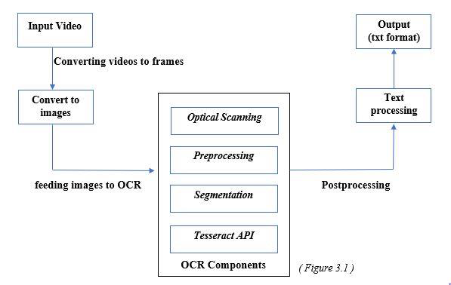
♔
4. Proposed work
By overcoming the above mentioned drawbacks, OCR comes up with the solution. OCR has many components and steps before going directly to the recognition and extraction phase. These feature are used to cleanup and filter the image to get accurate results. The following diagram shows the working and OCR internal components. I’ll explain this more clearly when we go further.
Flow diagram

Slide 7
Components of OCR
♖
Image
Optical Scanning
1
2
Preprocessing
Segmentation
3
4
Postprocessing
Output

Slide 8

♜
5.1 Optical Scanning
The first component in OCR is Optical Scanning. In OCR, Optical Scanning is used to covert the RGB image to Grayscale image. This is the important step in OCR, which can changes entire colored image into Grayscale image. It is because Processing on RGB (Red Green Blue) image is difficult, and it takes much time for execution of each pixel. The following image shows how the grayscale image looks like.
BEFORE AFTER
Original Image Grayscale Image

Slide 9
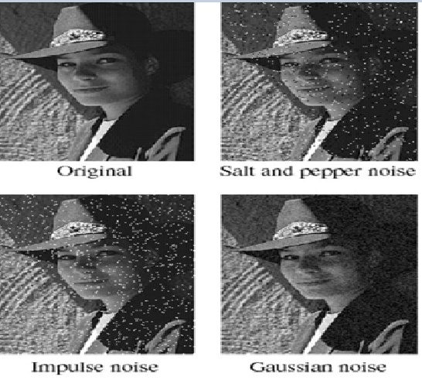
♜
5.2 Preprocessing
The second OCR component is preprocessing. The main objectives of preprocessing can be pointed as
Noise reduction
(b) Adaptive Thresholding.
Noise reduction:
The noise introduced by the optical scanning device or the writing instrument causes disconnected line segments, disturbances and gaps in lines, filled text, etc. The distortion including local variations, rounding of corners, dilation and erosion is a potential problem. By applying morphological operations like dilation, erosion, etc. The noise will be removed and image is smoothened.

Slide 10
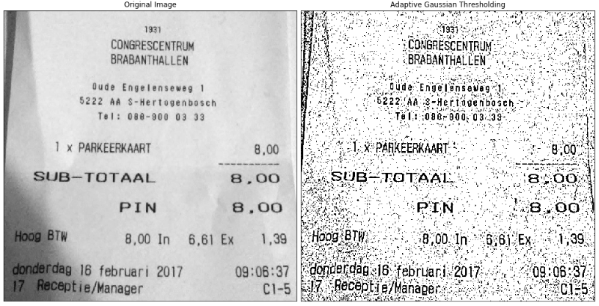
♜
5.2 Preprocessing
The second OCR component is preprocessing. The main objectives of preprocessing can be pointed as
Noise reduction
(b) Adaptive Thresholding:
Adaptive thresholding typically takes grayscale image as an input. For each pixel in the image, a threshold must be set and calculated, If the value is below the actual threshold value then it is set to the background value else it is set to foreground value. If your image processing package doesn’t contain an adaptive threshold operator, you can manually simulate it.

Slide 11
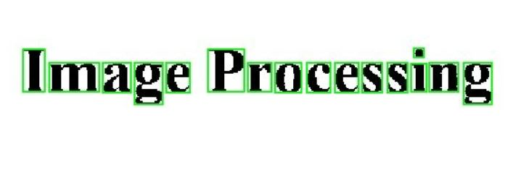
♜
5.3 Segmentation
The next OCR component is segmentation. Here the character image is recognized as segments. These segments are further processed by its trained model of ANN(Artificial Neural Network). Generally, segmentation is important because the extent one can reach in separation of the various lines in the characters directly affects the recognition rate. Internal segmentation is used here which isolates lines and curves in the cursively written characters. Though several remarkable methods have developed in the past and a variety of techniques have emerged, the segmentation of cursive characters is an unsolved problem

Slide 12
♜
5.4 Postprocessing
The next OCR component is postprocessing. Some of the commonly used postprocessing activities include grouping and redundant detection and correction. However, the extracted text from the image is not accurate and there is a chance of getting redundant text and some obfuscated values. To remove and process such type of text we use postprocessing technique in OCR. I’ve used Hashlib module in python to process and remove the redundant text in the saved text file. In this technique, removing redundant text is also an external and important task. After the postprocessing the final text file is saved in a folder.

Slide 13
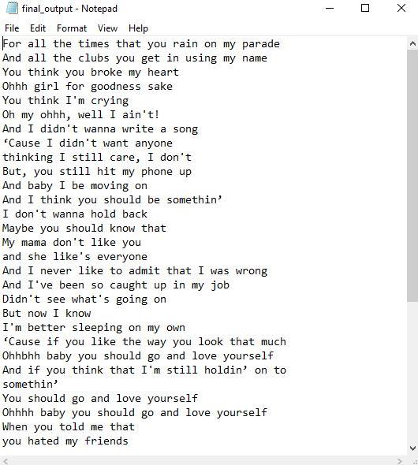
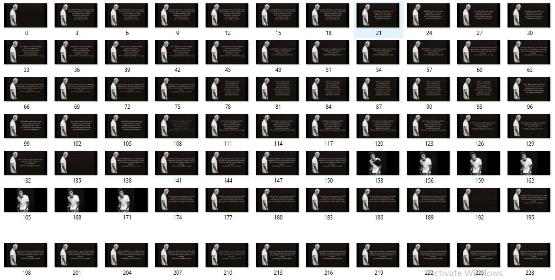
♜
6. Results & Future work
These are the screenshots and result of extraction of text from a video using OCR
Results:
Output text extracted from those images
Input frames or images

Slide 14
♗
6. Results & Future work
Future Work:
In this presentation, I’ve discussed only on printed or embedded text in an image. But in future, the work can be explored on Hand writing recognition.

Slide 15

THANK YOU
HAVE A NICE DAY
Made by
Fairoz Ahmed Shaik

